Slide 1
DO IT YOURSELF

Slide 2
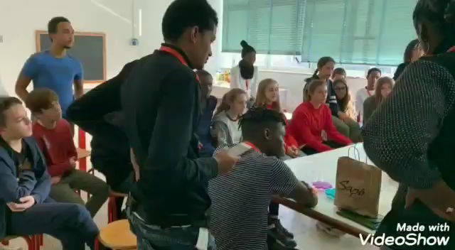
DO IT YOURSELF.

Slide 3
What we can do around Ferrare?
ECOTOURISM

Slide 4
What is it?
ECOTOURISM

Slide 5
We can walk.
ECOTOURISM

Slide 6
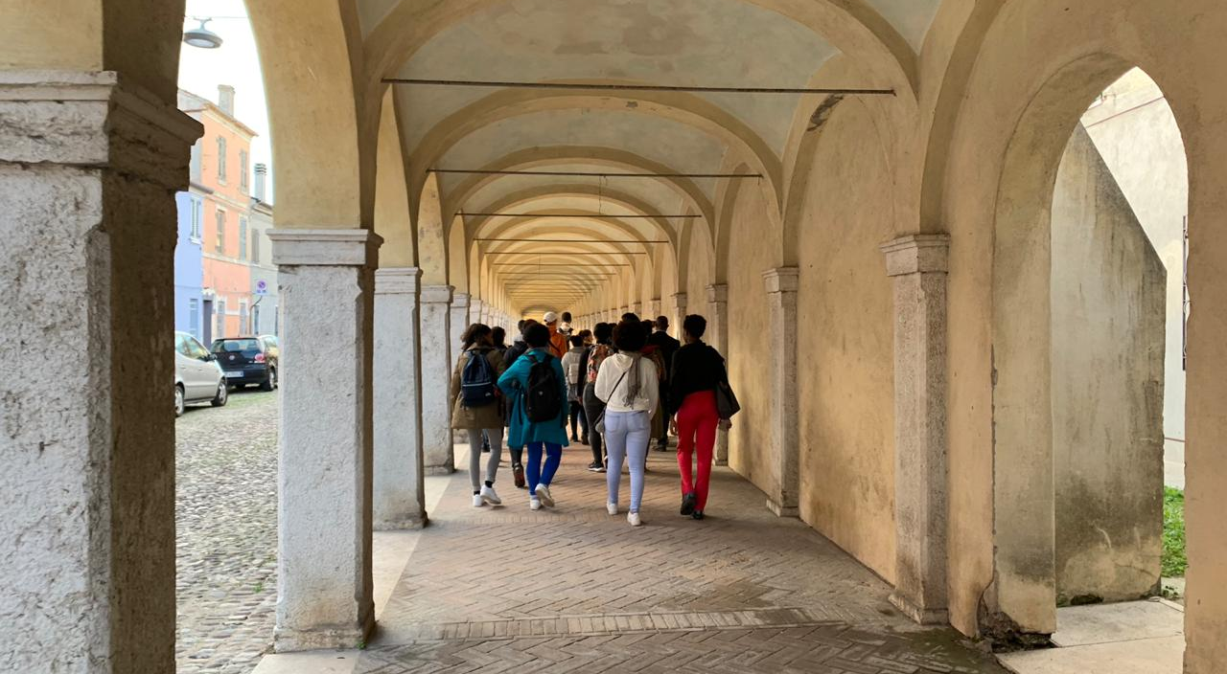
Going to Commacchio Cathedral

Slide 7
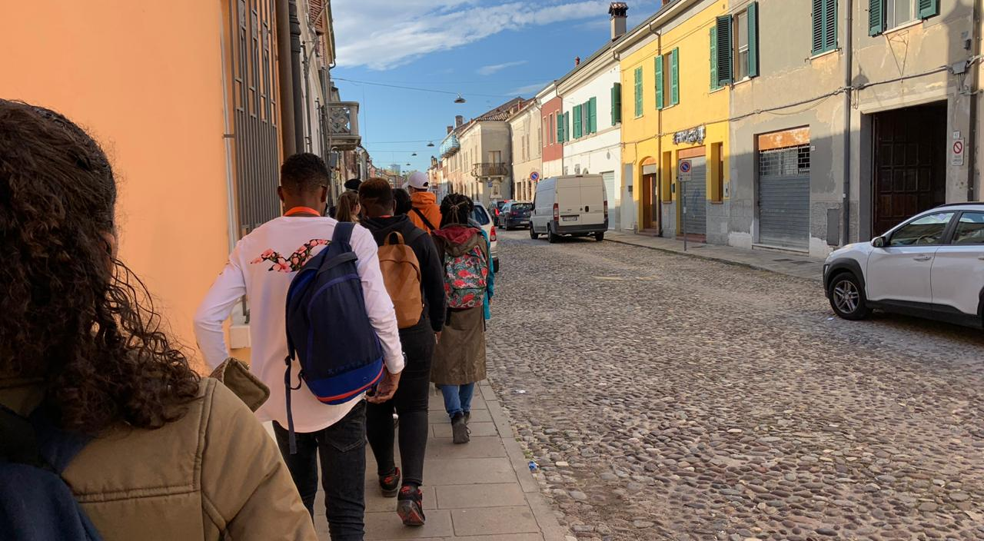
ECOTOURISM
Visiting Commacchio

Slide 8
We can go by boat.
ECOTOURISM

Slide 9
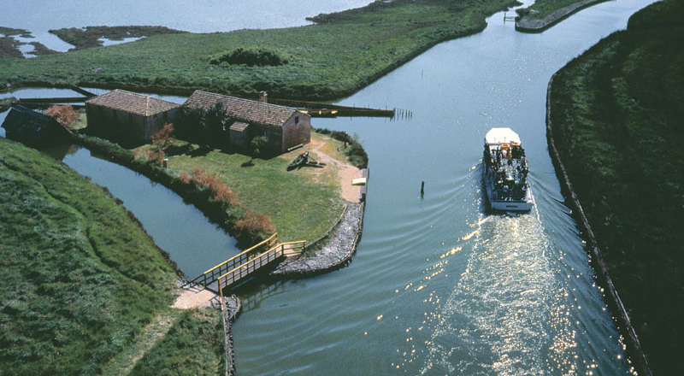
Po delta
ECOTOURISM

Slide 10
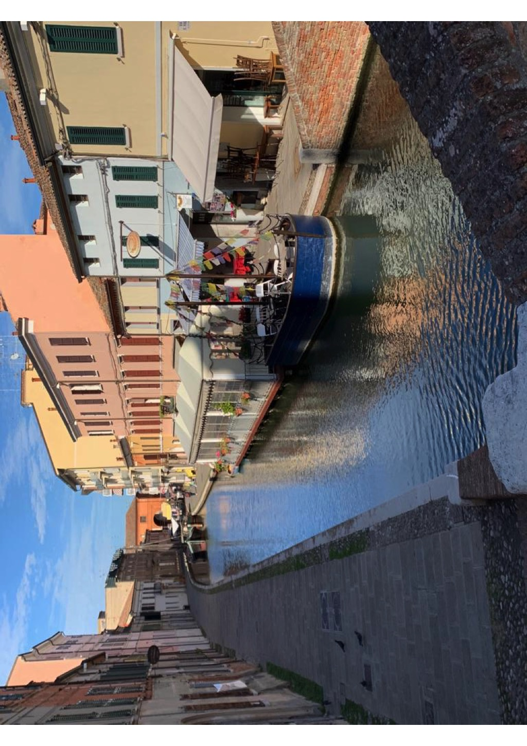

Slide 11
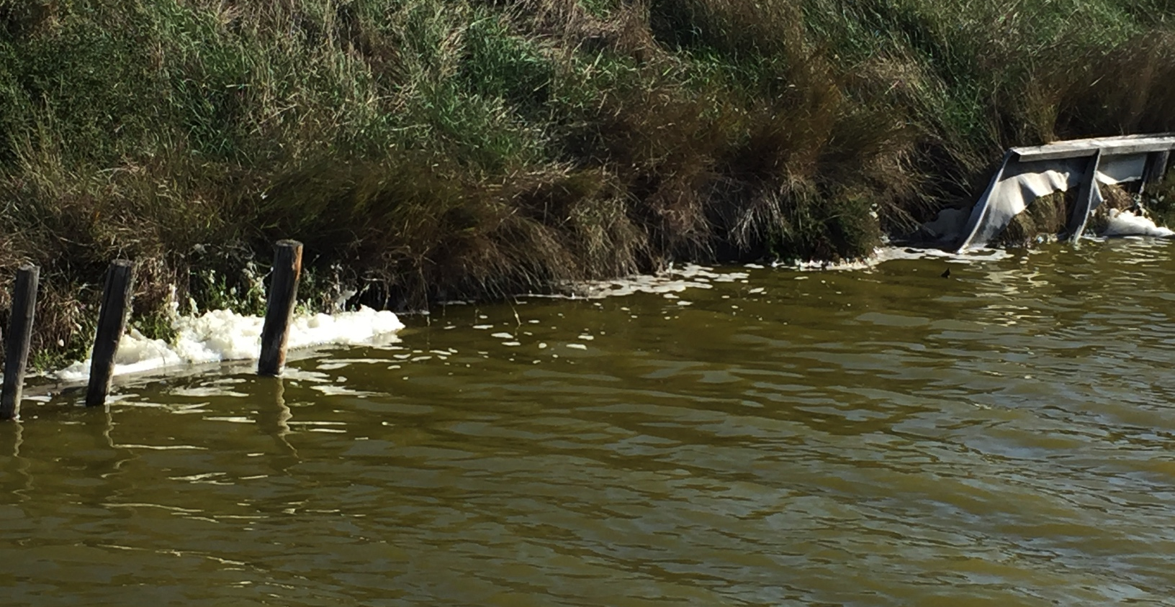
ECOTOURISM
foam

Slide 12
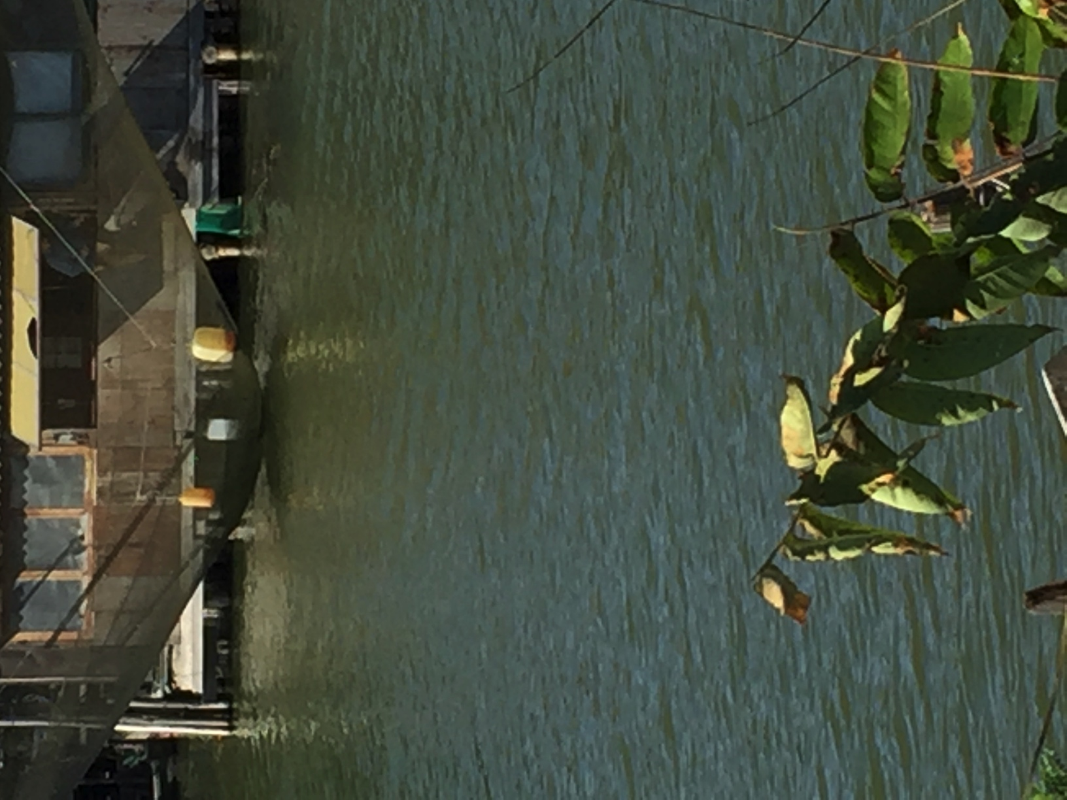
ECOTOURISM
Net

Slide 13
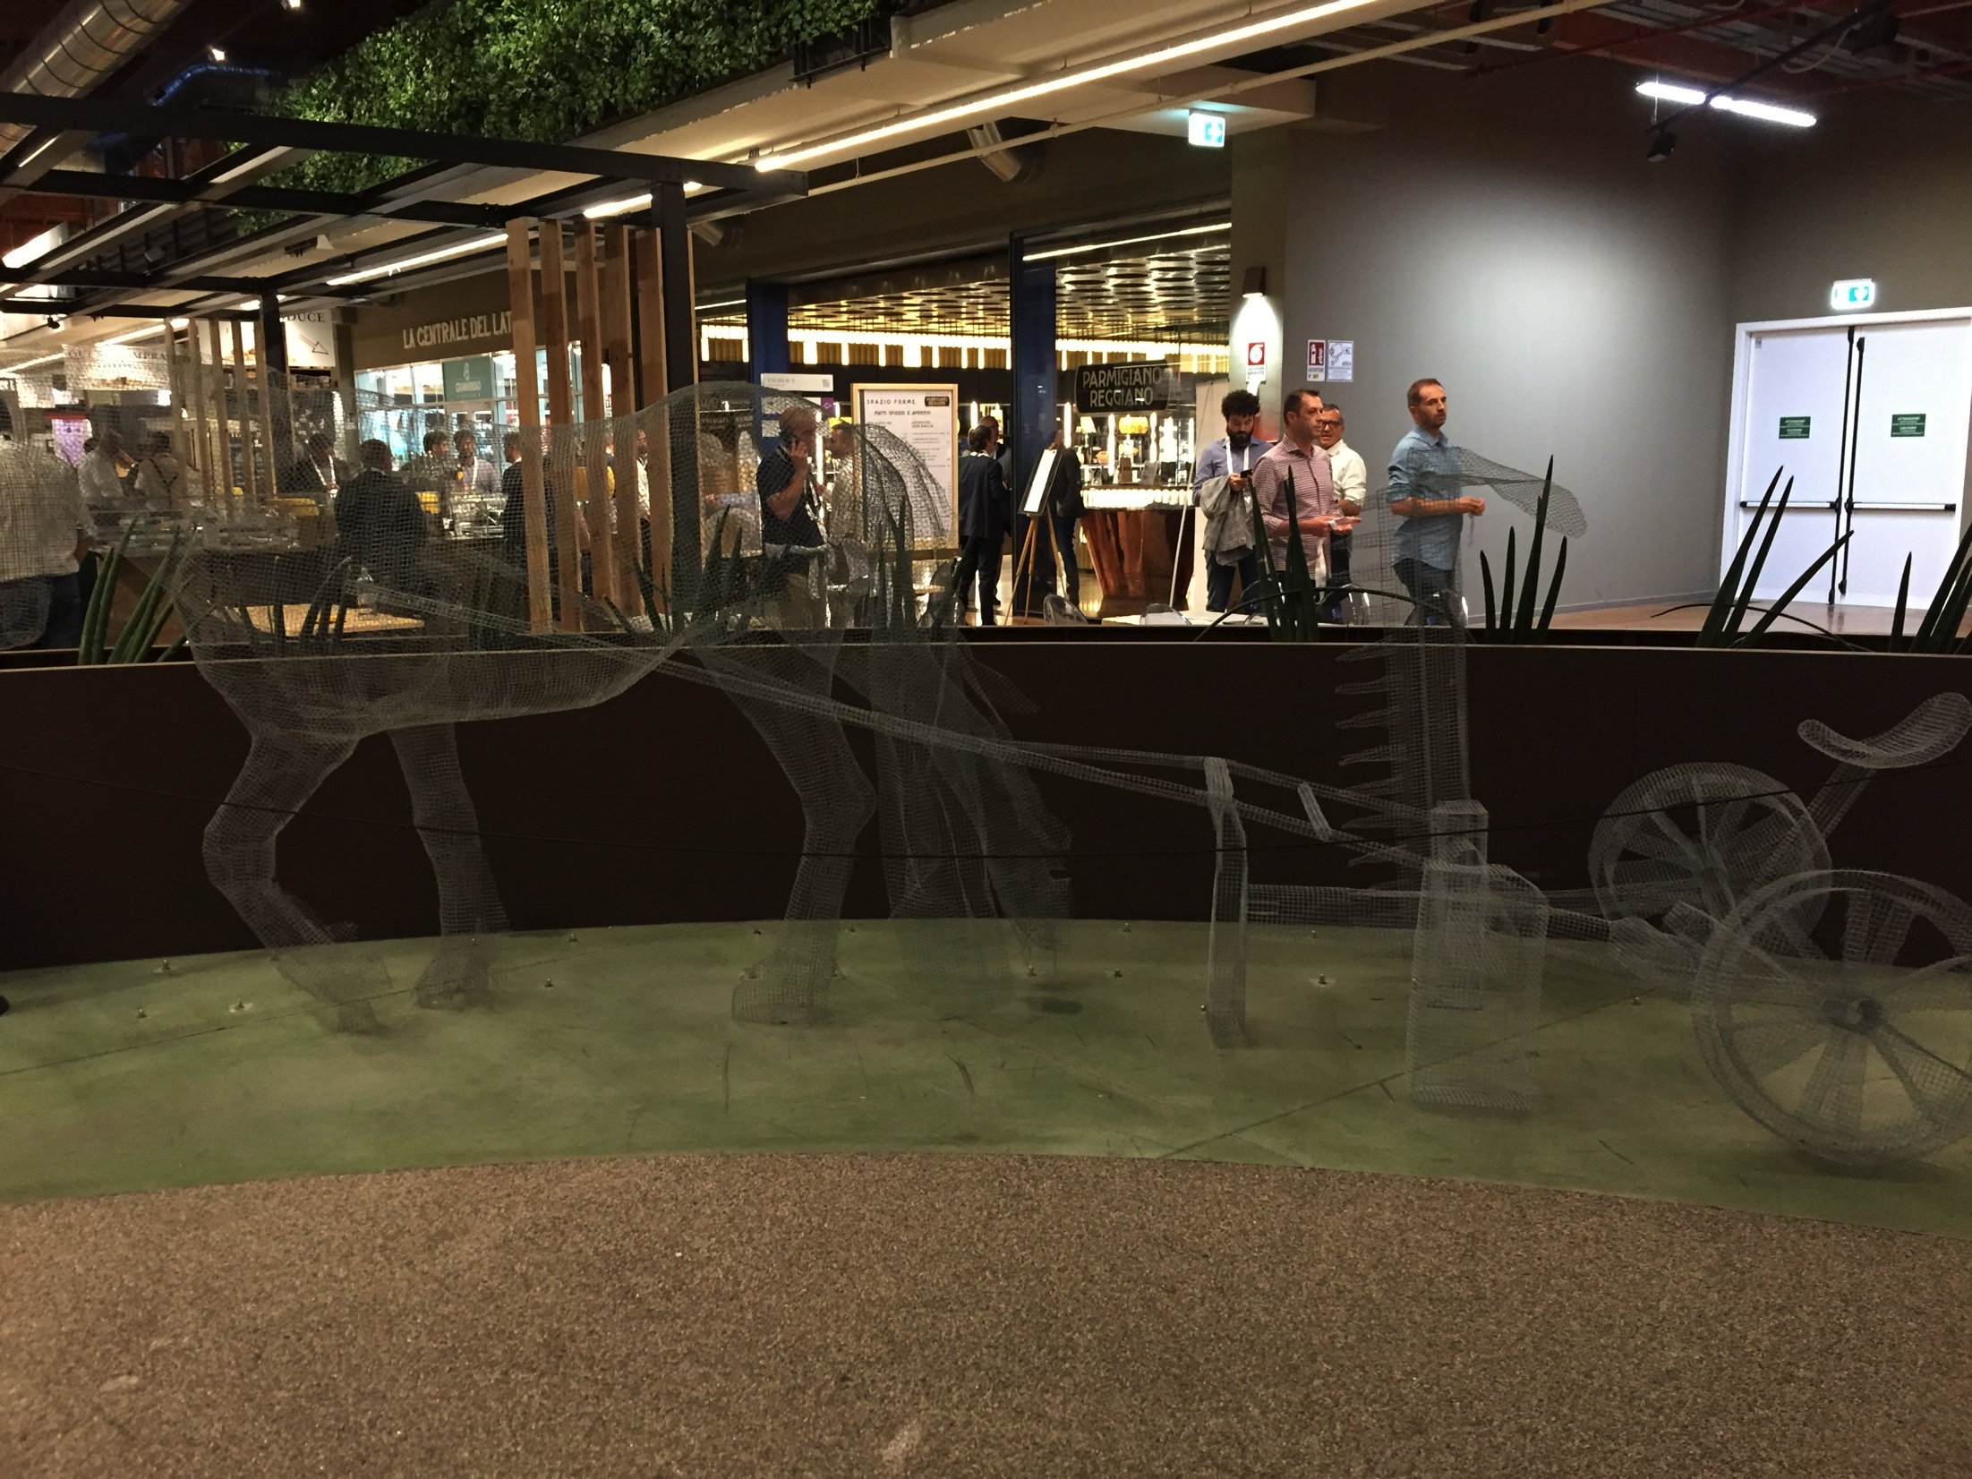
In Commacchio,you can also
ECOTOURISM
Riding horse
Observing animals

Slide 14
We can ride bicycle.
ECOTOURISM
We can visit the city by bike, it’s an opportunity to discover it with a good energy.
Cycling doesn’t pollute the environment, is not expensive, not easy but we can do it.
Bike is a compensation instead of taking car or bus.

Slide 15
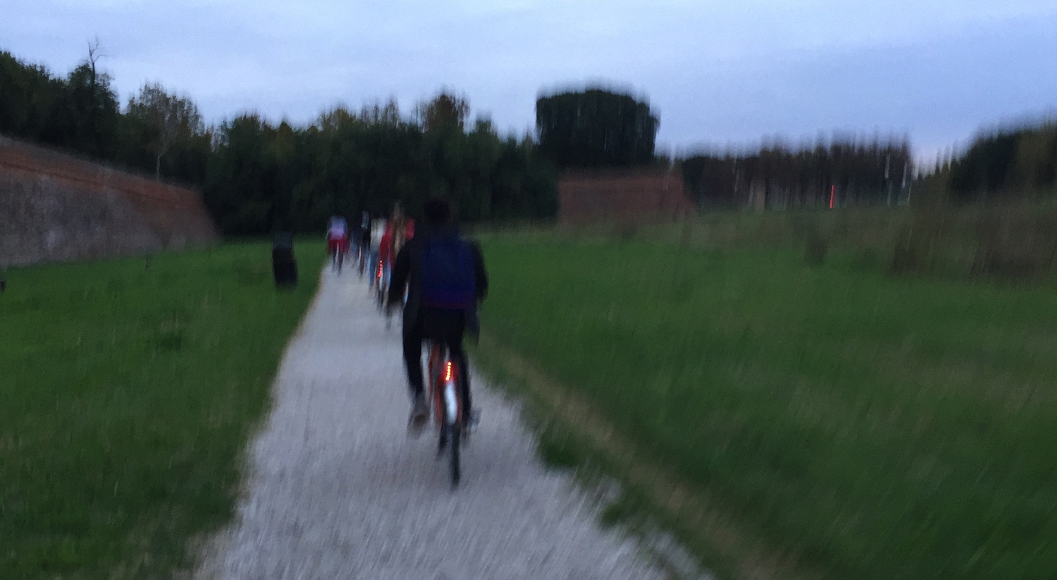
On our bicycle visiting the city walls

Slide 17
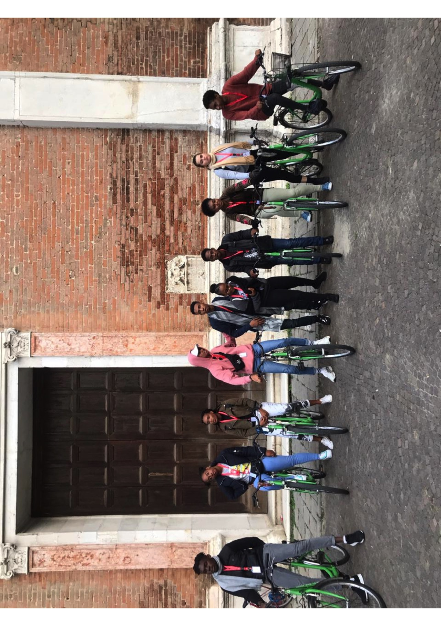
ECOTOURISM
Visiting Ferrare

Slide 18
What are the advantages?
ECOTOURISM
Ecotourism has a lot of advantages which concerned environment and economy.
For example it allows protection of the environment and the animal from the car gas.
Thanks to the ecotourism people can discover the territory in another way, it’s more funny !!
It can allows people to spend less money, because they don’t have to pay for transport.

Slide 19
What are the advantages?
ECOTOURISM
Thanks to the ecotourism people can discover the territory in aonther way, it’s more funny !!
It can allows people to be more economic too, because they don’t have to spend their money in transport.

Slide 20
What are the disadvantages?
ECOTOURISM
Ecotourism represents a positive evolution for biodiversity, it’s important to put into the perspective its impact, which does not only have advantages.

Slide 21
What are the disadvantages?
ECOTOURISM
Indeed, it is a still recent practice which is discovered from days to days and which can present deviations. Some companies will establish themselves in places with an unique biodiversity just to earn money. They can cause problem in the environment with the creation of infrastructures or the simple human presence.

